Slide 1

INDUSTRIAL AUTOMATION IN DAIRY INDUSTRY
A PROJECT REPORT
Submitted by
AKRAM BASHA. A | 211420105301
ARUN RAAJ. G.K | 211420105304
JOSHUA. E | 211420105311
KRISHNAN. S | 211420105314
in partial fulfilment for the award of the degree
of
BACHELOR OF ENGINEERING
in
ELECTRICAL AND ELECTRONICS ENGINEERING
PANIMALAR ENGINEERING COLLEGE
(An Autonomous Institution, Affiliated to Anna University, Chennai)
MAY 2024

Slide 2
PANIMALAR ENGINEERING COLLEGE
An Autonomous Institution, Affiliated to Anna University, Chennai)
BONAFIDE CERTIFICATE
Certified that this project report “ INDUSTRIALAUTOMATION IN DAIRY INDUSTRY ” is the bonafide workof “ AKRAM BASHA. A (211420105301), ARUN RAAJ. G.K(211420105304), JOSHUA. E (211420105311),
KRISHNAN. S(211420105314) ” who carried out the project work under my
supervision.
SIGNATURE
Dr. S.SELVI, M.E, Ph.D.
HEAD OF THE DEPARTMENT
PROFESSOR
Department of Electrical and Electronics Engineering, Panimalar Engineering College, Chennai-600 123
SIGNATURE
Dr. P.HARIRAMAKRISHNAN, M.E, Ph.D.
SUPERVISOR
ASSOSIATE PROFESSOR
Department of Electrical and Electronics Engineering, Panimalar Engineering College,
Chennai-600 123
Submitted for End Semester Project Viva Voce held on ................................ at
Panimalar Engineering College, Chennai.
INTERNAL EXAMINER EXTERNAL EXAMINER

Slide 3
ACKNOWLEDGEMENT
We would like to express our sincere thanks to our respected Chairman and Chancellor, Sathyabama University Dr. JEPPIAR M.A., B.L., Ph.D., for being in the vanguard of scientific progress in our college.
We would like to express our deep gratitude to our Beloved Secretary and Correspondent Dr. P.CHINNADURAI M.A., Ph.D., for extending his never- ending support to us.
We extend our sincere thanks to our Professor & Head of the Department, Electrical and Electronics Engineering, Dr. S. SELVI M.E, Ph.D. and a heartfelt thanks to our Professor Dr. D. SILAS STEPHEN M.E, Ph.D. for his timely guidance in technical front and for instilling immense confidence in us for completing our project successfully.
We are thankful and forever indebted to our Project Supervisor , Dr. .P.HARI RAMAKRISHNAN M.E, Ph.D., Professor for his insightful feedback and prompt assistance in completing our project.
We also extend our thanks to All Staff Members of Electrical and Electronics Engineering for their support and technical assistance. On a personal note, we would like to express our heartfelt thanks to our beloved Parents and our Friends, for their help and wishes in successfully completing this project. Thanks to Almighty for giving us the strength to do this project successfully.

Slide 4
ABSTRACT
Automation has revolutionized the food manufacturing industry by enabling faster and more efficient production processes. With the increasing demand for food products, manufacturers increasingly turn to automation to increase productivity, reduce costs, and enhance safety and quality standards. With the industry's growth projected to continue, manufacturers must adopt automation technologies to keep up with demand while maintaining high safety and quality standards. The use of automation in food manufacturing processes has many benefits. Automated systems can reduce the risk of human error and contamination; ensuring food safety standards are met.
They also enable manufacturers to maintain consistency in production quality, minimize waste, and improve efficiency. Additionally, automation technologies can help reduce labor costs, allowing manufacturers to invest in other business areas. Recent advancements in automation technology have led to the development of intelligent systems that can learn and adapt to different situations, improving production processes' effectiveness and efficiency. Integrating the Internet of Things (IoT) technology into food manufacturing processes have enabled real-time monitoring and data collection, leading to better decision-making and improved production processes. As automation technologies continue to advance, the food manufacturing industry must keep up with these trends to remain competitive.
4
( 1 )

Slide 5
CONTENTS
CHAPTER Page No.
Acknowledgement........................................................................................([iii)
Synopsis… ...................................................................................................(iv)
List of Figures.............................................................................................(v)
1. INTRODUCTION .................................................................................[1]
Problem Statement
Organization of the report
[1]
[2]
2. INDUSTRIAL AUTOMATION IN FOOD INDUSTRY
[3]
[3]
[3]
Industrial automation in dairy products
System architecture
3. HARDWARE IMPLEMENTATION .......................................................[7]
Node MCU
ESP32-CAM
LCD
ADS 1115 16 bit ADC
Heat Rod
H-Bridge
12 V SMPS
MCQ 135 Gas Sensor
LM35 Temperature Sensor
[7]
[9]
[10]
[12]
[14]
[15]
[17]
[19]
[20]
[22]
10. PH Sensor
4. SOFTWARE IMPLEMENTATION .......................................................[23]
5. ALGORITHM OF SYSTEM………….…………………………….. …...[27]
6. HARDWARE MODEL IMPLEMENTATION…...………………………[33]
7. CONCLUSION…………………………………………………….……. [34]
8. BIBILOGRAPHY……………………..……………..…………………....[35]
( vi )
6

Slide 6
LIST OF FIGURES
Figure No. | Title | Page no
3.1 | Node MCU | 7
3.2 | ESP32-CAM | 9
3.3 | Liquid Crystal Display | 11
3.4 | ADS-1115 16Bit ADC | 12
3.5 | Heat Coil | 14
3.6 | H-Bridge | 15
3.7 | 12V SMPS | 17
3.8 | MCQ Gas sensor | 19
3.9 3.10 | LM35 Temperature Sensor PH Sensor | 20 22
4.1 | Conventional Sensor Network | 23
4.2 | Sensor Network Over Cloud | 23
4.3 | Structure of IoT | 24
4.4 | Possible Outcome Of Project | 25
6.1 | Hardware implementation of a work | 33
5( v )

Slide 7
CHAPTER 1 INTRODUCTION
1.1 PROBLEM STATEMENT:
The modern dairy industry plays a vital role in meeting the increasing global demand for high-quality dairy products. However, it faces several critical challenges that need innovative solutions. Inconsistencies in milk quality, stemming from factors like cow health, environmental conditions, and equipment malfunctions, can lead to product defects and consumer dissatisfaction. Traditional quality control methods, reliant on periodic sampling and lab testing, lack the capability to provide real-time feedback for quality management. Operational inefficiencies, including waste, downtime, and resource utilization, need to be minimized to meet growing demand efficiently.
Furthermore, consumer trust in the dairy industry is crucial, as high-profile cases of milk contamination have eroded confidence in the safety and quality of dairy products. To address these challenges, an innovative solution is required, one that leverages cutting-edge technology. The Industrial Milk Monitoring System (IMMS) represents a groundbreaking
approach that integrates Internet of Things (IoT) technology, real-time video
streaming, and a user-friendly web application interface.
By continuously monitoring and enhancing milk quality parameters in real-
time throughout the production process, IMMS aims to ensure product

Slide 8
consistency, optimize operations, and rebuild consumer trust. This system will not only address the challenges associated with milk quality but also provide efficient data management and analysis capabilities, facilitating informed decision-making and process improvement in the dairy industry.
1.2 ORGANIZED OF THE REPORT
The report is organized into seven chapters. Each chapters describe an
Individual component of this work. The report is organized in such a way that The topics are in procedural manner.
Chapter 2 Describes about the Industrial automation in dairy products and The advantages of industrial automation in milk industry
Chapter 3 Summarize about the Hardware presents the brief summary of the components that are used in this work. The description about the individual components are listed.
Chapter 4 Describes about the software implementation.
Chapter 5 summarize about the algorithm for the selection of the best
optimized algorithm.
Chapter 6 Describe the implementation of Hardware Model , The output of the work is also shown.
Chapter 7 brief the conclusion we obtained from this project, and the scope of the improvement of this project is also depicted.

Slide 9
CHAPTER 2
2.1 ADVANTAGES OF INDUSTRIAL AUTOMATION IN MILK INDUSTRY
Reduced health risks: Pasteurization eliminates harmful bacteria, such as
E. coli and Salmonella, making heated and processed milk safer, especially
for vulnerable populations like children, elderly, and pregnant women.
Extended shelf life: Processed milk lasts longer, reducing the risk of spoilage and waste, making it more convenient for consumers.
Consistency: Processed milk ensures uniform taste and texture, providing a
reliable product with each purchase.
Convenience: Availability in grocery stores and longer shelf life makes heated and processed milk easier to access and use for everyday consumption.
Nutritional value: While pasteurization may slightly reduce certain heat- sensitive nutrients, processed milk still retains most of its essential vitamins and minerals, contributing to a balanced diet.
2.2 DIFFERENCES OF INDUSTRIAL AUTOMATION FROM CONVENTIONAL PROCESS
Safety: Heated and processed milk has undergone pasteurization, which kills harmful bacteria and pathogens, making it safer to consume compared to raw milk, which can carry potential health risks.
Shelf life: Processed milk has a longer shelf life due to pasteurization and homogenization, while raw milk has a shorter shelf life and requires immediate consumption or refrigeration.

Slide 10
Flavor and texture: Heated and processed milk generally has a more consistent flavor and smoother texture compared to raw milk, which can vary in taste and have cream separation.
Availability: Processed milk is widely available in grocery stores, while raw milk is less common due to stricter regulations and safety concerns.
Legal regulations: The production and sale of raw milk are often subject to
2.3 SYSTEM ARCHITECTURE
The IMMS architecture consists of multiple interconnected components that
work seamlessly to monitor, control, and analyse milk quality in real time
IOT Sensors: Specialized pH, gas, and temperature sensors are strategically placed within the milk processing setup. These sensors provide real-time data about the milk's chemical composition and physical state.

Slide 11
Real-time Video Streaming: Cameras are installed at key points within the processing facility, enabling real-time video feeds of the milk production process. This visual data complements the sensor-generated data, enhancing the system's accuracy and enabling remote monitoring.
Web Application Interface: The heart of IMMS is an intuitive web-based application accessible from any device with an internet connection. This interface offers users a comprehensive overview of the production process, real-time data analytics, and remote-control options.
Automated Control Mechanisms: IMMS includes automated mechanisms such as stirring and dispensing systems that can be remotely controlled through the web interface. These mechanisms ensure uniform distribution of additives and maintain the desired milk consistency.

Slide 12
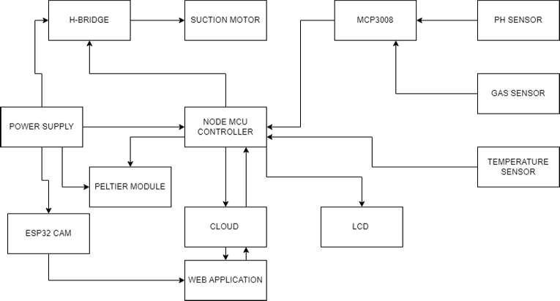
2.4 BLOCK DIAGRAM

Slide 13
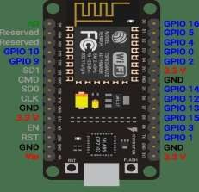
CHAPTER 3
HARDWARE IMPLEMENTATION
3.1 NODE MCU:
Fig.3.1 Node MCU
A popular ESP8266-based development board with built-in Wi-Fi connectivity.
Microcontroller: ESP8266 (32-bit Ten silica Xtensa LX106)
Operating Voltage: 3.3V
GPIO Pins: 11 digital GPIO pins, 1 analog input pin
Communication: Wi-Fi (802.11 b/g/n), UART, SPI, I2C
Flash Memory: 4MB
USB Interface: Micro USB
The Atmel AVR core combines a rich instruction set with 32 general purpose working registers. All the 32 registers are directly connected to the Arithmetic Logic Unit (ALU), allowing two independent registers to be accessed in a single instruction executed in one clock cycle. The resulting architecture is more code efficient while achieving throughputs up to ten times faster than conventional

Slide 14
CISC microcontrollers. The ATmega328/P provides the following features: 32Kbytes of In-System Programmable Flash with Read-While-Write capabilities, 1Kbytes EEPROM, 2Kbytes SRAM, 23 general purpose I/O lines, 32 general purpose working registers, Real Time Counter (RTC), three flexible Timer/Counters with compare modes and PWM, 1 serial programmable USARTs , 1 byte-oriented 2-wire Serial Interface (I2C), a 6- channel 10- bit ADC (8 channels in TQFP and QFN/MLF packages) , a programmable Watchdog Timer with internal Oscillator, an SPI serial port, and six software selectable power saving modes.
This allows very fast start-up combined with low power consumption. In Extended Standby mode, both the main oscillator and the asynchronous timer continue to run. Atmel offers the Touch library for embedding capacitive touch buttons, sliders and wheels functionality into AVR microcontrollers. The patented
charge-transfer signal acquisition offers robust sensing and includes fully debounced reporting of touch keys and includes Adjacent Key Suppression (AKS™) technology for unambiguous detection of key events. The easy-to-use Q Touch Suite toolchain allows you to explore, develop and debug your own touch applications. The device is manufactured using Atmel’s high density non- volatile memory technology. The On-chip ISP Flash allows the program memory to be reprogrammed In-System through an SPI serial interface, by a conventional non-volatile memory programmer, or by an On-chip Boot program running on the AVR core.

Slide 15
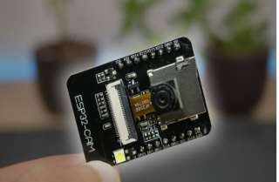
3.2 ESP32-CAM:
Fig. 3.2 ESP32-CAM
ESP32-based development board with built-in camera module.
Microcontroller: ESP32 (dual-core Tensilica LX6)
Operating Voltage: 3.3V
GPIO Pins: Varies based on the specific board, typically has around
11GPIO pins
Communication: Wi-Fi (802.11 b/g/n), Bluetooth, UART, SPI, I2C
Camera: OV2640 2MP CMOS camera
Flash Memory: 4MB
USB Interface: Micro USB

Slide 16
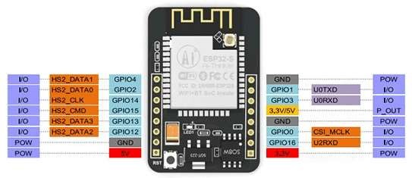
Fig.3.3 Configuration of ESP32-CAM
There are three GND pins and two pins for power: either 3 or 5V.
GPIO 1 and GPIO 3 are the serial pins. You need these pins to upload code
to your board. Additionally, GPIO 0 also plays an important role, since it
determines whether the ESP32 is in flashing mode or not. When GPIO 0 is connected to GND, the ESP32 is in flashing mode.
The following pins are internally connected to the microSD card reader:
GPIO 14: CLK
GPIO 15: CMD
GPIO 2: Data 0

Slide 17
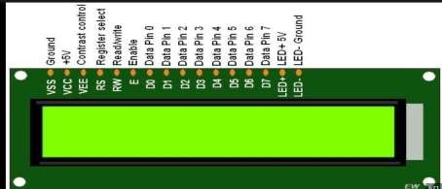
3.3 LIQUID CRYSTAL DISPLAY (LCD)
Fig.3.3 Liquid Crystal Display
Type: Character LCD
Size: Varies based on the specific model, e.g., 16x2, 20x4
Communication: Parallel or I2C (with I2C backpack)
Backlight: LED backlight (usually blue or white)
Display Mode: Alphanumeric characters and symbol
Used for displaying information and data feedback in text format.
A Liquid Crystal Display (LCD) is an electronically-modulated optical device shaped into a thin, flat panel made up of any number of colour or monochrome pixels filled with liquid crystals and arrayed in front of a light source (backlight) or reflector. It is often utilized in battery-powered electronic devices because it uses very small amounts of electric power.
LCD has material, which continues the properties of both liquids and crystals. Rather than having a melting point, they have a temperature range within which the molecules are almost as mobile as they would be in a liquid, but are grouped together in an ordered from similar to a crystal. They are

Slide 18
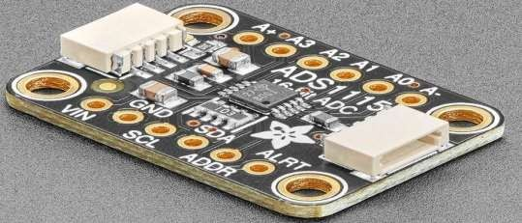
used in similar applications where LEDs are used. These applications are display of display of numeric and alphanumeric characters in dot matrix and segmental displays.
LCD consists of two glass panels, with the liquid crystal materials sandwiched in between them. The inner surface of the glass plates is coated with transparent electrodes which define in between the electrodes and the crystal, which makes the liquid crystal molecules to maintain a defined orientation angle. When a potential is applied across the cell, charge carriers flowing through the liquid will disrupt the molecular alignment and produce turbulence. When the liquid is not activated, it is transparent.
When the liquid is activated, the molecular turbulence causes light to be scattered in all directions and the cell appears to be bright. Thus, the required message is displayed. When the LCD is in the off state, the two
polarizers and the liquid crystal rotate the light rays, such that they come out
of the LCD without any orientation, and hence the LCD appears transparent.
Fig.3.4 ADS-1115 1Bit ADC

Slide 19
Wide Supply Range: 2.0V to 5.5V
Low Current Consumption: Continuous Mode: Only 150µa Single-Shot
Mode: Auto Shut-Down
Programmable Data Rate: 8sps to 860sps
Internal Low-Drift Voltage Reference
Internal Oscillator
Internal PGA
I2c Interface: Pin-Selectable Addresses
Four Single-Ended or Two Differential Inputs
Programmable Comparator
The ADS1115 can perform conversion operations at a rate of up to 860 samples per second (SPS). The ADS1115 has an on-board programmable gain amplifier (PGA) that can provide an input range as low as ±256mV from the power supply voltage, thus enabling the measurement of large and small signals with high resolution. In addition, the ADS1115 also has an input multiplexer (MUX), which can provide 2 differential inputs or 4 single-ended inputs.ADS1115 can work in continuous conversion mode or single trigger mode, the latter will automatically power off after a conversion is completed, thereby greatly reducing the current consumption in the idle state. ADS1115 has a specified temperature range from -40°C to +125°C.

Slide 20
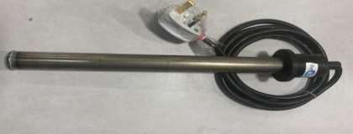
3.5 HEATING ROD
Fig.3.5 Heat coil
Composition (Tin/Lead):
The heating rod is composed of a mixture of Tin and Lead. It is available in
two different compositions: 60/40 Tin/Lead and 63/67 Tin/Lead. This indicates the percentage of Tin and Lead in the alloy.
Working Temperature:
The heating rod can operate within a temperature range of 200 to 300 degrees Celsius. This means it is designed to provide heat within this temperature range without any issues related to material degradation or
performance.
Material:
The heating rod is primarily constructed from Tin, a metal known for its good
thermal conductivity and corrosion resistance. This makes it suitable for
various heating applications.
Length:
The heating rod is available in various lengths ranging from 300 mm
(millimetres) to 500 mm.The length can be chosen based on the specific application and the depth of the liquid or substance that needs to be heated.

Slide 21
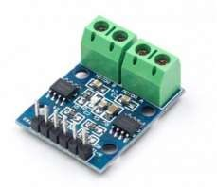
Operating Current:
The heating rod requires an operating current in the range of 0.15 to 0.3 A
(Amperes).The current may vary depending on the specific model and
wattage of the heating element.
Operating Voltage:
The heating rod is designed to operate at a voltage of 230V (Volts).This
voltage is common for many electrical appliances and industrial equipment.
3.6 H-BRIDGE:
Fig.3.6 H-Bridge
The Device is a monolithic integrated high voltage, high current four channel driver designed to accept standard DTL or TTL logic levels and drive inductive loads (such as relays solenoids, DC and stepping motors) and switching power transistors. To simplify use as two bridges each pair of channels is equipped with an enable input. A separate supply input is provided for the logic, allowing operation at a lower voltage and internal clamp diodes are included. This device is suitable for use in switching applications at frequencies up to 5 kHz. The L293D is assembled in a 16lead plastic package which has 4 centre pins connected together and used for heatsinking The L293DD is assembled in a 20 lead surface mount which has 8 centre pins connected together and used for heatsinking.

Slide 22
The L293 and L293D are quadruple high-current half-H drivers. These devices are designed to drive a wide array of inductive loads such as relays, solenoids, DC and bipolar stepping motors, as well as other high-current and high-voltage loads. All inputs are TTL compatible and tolerant up to 7 V. Each output is a complete totem-pole drive circuit, with a Darlington transistor sink and a pseudo-Darlington source. Drivers are enabled in pairs, with drivers 1 and 2 enabled by 1,2EN and drivers 3 and 4 enabled by 3,4EN. When an enable input is high, the associated drivers are enabled, and their outputs are active and in phase with their inputs. When the enable input is low, those drivers are disabled, and their outputs are off and in the high-impedance state. With the proper data inputs, each pair of drivers forms a full-H (or bridge) reversible drive suitable for solenoid or motor applications. On the L293, external high-speed output clamp diodes should be used for inductive transient suppression. On the L293D, these diodes are integrated to reduce system complexity and overall system size. A VCC1 terminal, separate from VCC2, is provided for the logic inputs to minimize device power dissipation. The L293 and L293D are characterized for operation from 0°C to 70°C.
A typical application for the L293 device is driving a two-phase motor. Below is an example schematic displaying how to properly connect a two-phase motor to the L293 device. Provide a 5-V supply to VCC1 and valid logic input levels to data and enable inputs. VCC2 must be connected to a power supply capable of supplying the needed current and voltage demand for the loads connected to the outputs VCC1 is 5 V ± 0.5 V and VCC2 can be same supply as VCC1 or a higher voltage supply with peak voltage up to 36 V. Bypass capacitors of 0.1 uF or greater should be used at VCC1 and VCC2

Slide 23
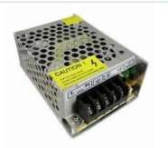
pins. There are no power up or power down supply sequence order requirements.
3.7 12V SMPS:
Fig.3.7 12V SMPS
Switched Mode Power supply uses a switching regulator to convert electric power efficiently. SMPS transfers electric power from a source (AC mains) to the load by converting the characteristics of current and voltage. SMPS always provide a well-regulated power to the load irrespective of the input variations. SMPS incorporates a Pass transistor that switches very fast typically at 50Hz and 1 MHz between the on and off states to minimize the energy waste. SMPS regulates the output power by varying the on to off time using minimum voltage so that efficiency is very high compared to the linear power supply.
The SMPS essentially has
Input rectifier
Inverter
Voltage converter
Output regulator

Slide 24
Input rectifier
The AC input from mains is first rectified in the SMPS using a rectifier to
convert it into DC. The rectifier consisting of a full wave diode bridge or module that produces an unregulated DC voltage to the Smoothing capacitor. The input AC passing into the rectifier has AC voltage pulses that may reduce the power factor. So control techniques are used to force the average input current to follow the sine wave.
Inverter
This stage converts the rectified DC into AC using a power oscillator. The
power oscillator has a small output transformer with a few windings at the
frequency 20-100 kHz. Switching is controlled by a MOSFET amplifier. The output AC voltage is usually isolated optically from the input AC by using
an Optocoupler IC for safety reasons.
Voltage converter
This stage has a high frequency transformer and the inverted AC drives its
primary windings. This creates the up and down voltage at the output. If DC
is required, the output AC is converted to DC using a rectifier circuit using Silicon diodes or Schottky diodes (fast recovery and minimum loss of current and low forward voltage drop). The rectified output DC is then filtered using the filtersection consisting of inductors and capacitors. Some non-isolated SMPS contains an inductor instead of the transformer and the circuit act as boost converter or buck converter. In high voltage SMPS, Capacitor- Diodemultiplier is used instead of inductors or transformer.
Output regulator
The output stage always monitors the output voltage by comparing with
a reference voltage using a feedback system. For safety reasons, the output

Slide 25
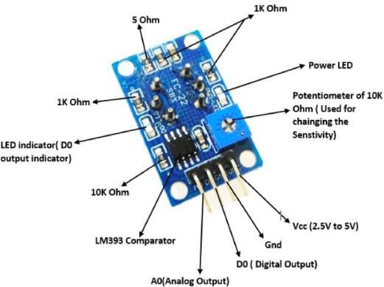
stage is isolated by an opto-isolator as seen in the SMPS of computers. In some SMPS, Open loop regulation is used without feedback circuit and constant voltage is fed to the transformer input.
3.8 MCQ GAS SENSOR:
Fig.3.8 MCQ Gas sensor
The MQ-135 Gas sensor can detect gases like Ammonia (NH3), sulphur (S), Benzene (C6H6), CO2, and other harmful gases and smoke. Similar to other MQ series gas sensor, this sensor also has a digital and analog output pin. When the level of these gases goes beyond a threshold limit in the air the digital pin goes high. This threshold value can be set by using the on- board potentiometer. The analog output pin, outputs an analog voltage which can be used to approximate the level of these gases in the atmosphere. The MQ135 air quality sensor module operates at 5V and consumes around 150mA. It requires some pre-heating before it could actually give accurate results.

Slide 26
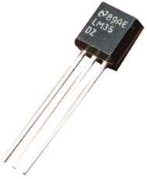
3.9 LM35 TEMPERATURE SENSOR:
Fig 3.9 LM35 Temperature Sensor
Specifications
Calibrated Directly in Celsius (Centigrade)
Linear + 10-mV/°C Scale Factor
0.5°C Ensured Accuracy (at 25°C)
Rated for Full −55°C to 150°C Range
Suitable for Remote Applications
Low-Cost Due to Wafer-Level Trimming
Operates From 4 V to 30 V
Less Than 60-µA Current Drain
Low Self-Heating, 0.08°C in Still Air
Non-Linearity Only ±¼°C Typical
Low-Impedance Output, 0.1 Ω for 1-mA Load
Body Temperature Measurement

Slide 27
The LM35 series are precision integrated-circuit temperature devices with an output voltage linearly-proportional to the Centigrade temperature. The LM35device has an advantage over linear temperature sensors calibrated in Kelvin, as the user is not required to subtract a large constant voltage from the output to obtain convenient Centigrade scaling.
The LM35 device does not require any external calibration or trimming to
provide typical accuracies of ±¼°C at room temperature and ±¾°Cover a full
−55°C to 150°C temperature range. Lower cost is assured by trimming and calibration at the wafer level. The low-output impedance, linear output, and precise inherent calibration of the LM35 device makes interfacing to readout
or control circuitry especially easy. The device is used with single power
supplies, or with plus and minus supplies.
As the LM35 device draws only 60 µA from the supply, it has very low self-
heating of less than 0.1°C in still air. The LM35 device is rated to operate over a −55°C to 150°C temperature range, while the LM35C device is rated for a −40°C to 110°C range (−10° with improved accuracy).
The LM35-series devices are available packaged in hermetic TO transistor
packages, while the LM35C, LM35CA, and LM35D devices are available in
the plastic TO-92 transistor package. The LM35D device is available in an 8- lead surface-mount small-outline package and a plastic TO-220 package.

Slide 28

3.10 PH SPECIFICATION:
Fig 3.10 PH Sensor
Measuring range: 0-14 pH
Accuracy: ± 0.1 pH
Response time: <1 minute
Temperature during use: 0-80 ° C
Interference: <0.5 mV
Output: Analog values in the range of (0.5V to 3V)
Other specifications include:
Module power: DC 9.00V 1A
Current: 5-10mA
Probe interface: BNC
Wire length: 80cm
Operating voltage: 5V DC

Slide 29
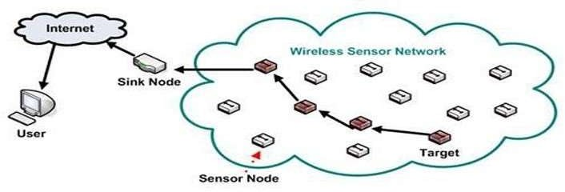
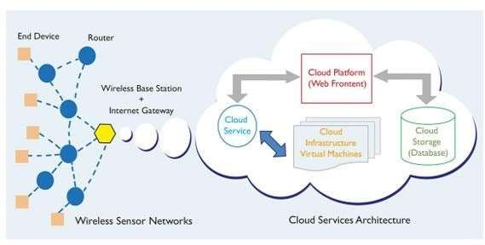
CHAPTER 4
SOFTWARE IMPLEMENTATION
STEP 1: Building of sensor network
Fig.4.1 Conventional Sensor Network
A conventional sensor network is a radio network of sensor nodes with ability to sense physical parameters, store sensed data, carry out simple processing on data and forward the data through radio interface. The objective of such network is to push the data to a sink node which can then forward the data to server (or cloud) is shown in the figure 4.1.
STEP 2: Connection of sensor network to the cloud
Fig. 4.2 Sensor Network Over Cloud

Slide 30
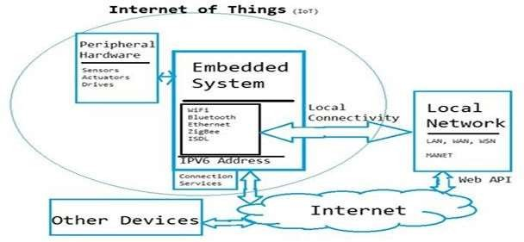
Figure 4.2 shows the connection between sensor network and the cloud. However, many real time applications include sensors spread over long areas. As such they are treated as independent networks. Internet of Things is a new paradigm of connecting devices like microcontrollers and smart objects to cloud. Using IoT services, we can now connect sensors to internet directly. One of common design of sensor network includes cluster-based methods where clusters are at formed by group of nodes. These are also called coordinator nodes. These nodes gather data from all neighbouring nodes. If these nodes can be linked to internet with their unique Ip addresses, then the sensor network can be infinitely scaled(theoretically).
STEP 3: Interfacing with the embedded system.
Fig.4.3 Structure of IOT
The basic structure of IoT is presented above. Our work would include following innovative research extensions to the existing WSN and IoT framework. Firstly, we would focus purely on sensors and that too on coordinator nodes in Peripheral hardware. Rather than working on

Slide 31
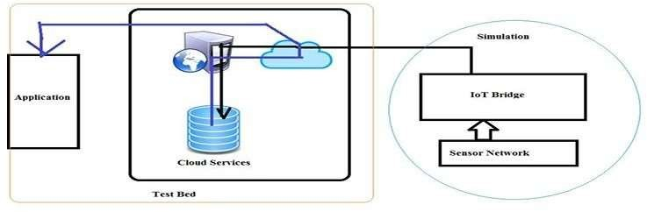
integrating individual hardware over cloud, our method would assume entire standalone sensor 29 network as a single peripheral and would connect that to cloud though IoT. We would focus mainly on ZigBee as wireless technology as that is most accepted WSN standard. Our methods would provide not only communication services but also data gathering and analysis services. We would integrate both simulation as well as real time test beds to prove the designed concepts.
STEP 4: Possible outcome of the IoT
Fig.4.4 Possible Outcome of Project
In the project work we mainly focus on building more comprehensive state of
art cloud extension of WSN through IoT. Firstly, the research would focus towards bettering each of the current state of art building blocks including but not limited to sensor network, coordinator protocol, data analysis in sensor network, cloud services, IoT protocols and so on. One of the first expected result would be a unique framework to connect existing WSN to cloud. Then system should prove the advantage of such extension by demonstrating the scale of improvement in data analysis services. Results should prove that IoT can be used to create mesh sensor networks and

Slide 32
enhanced bandwidth can be used to connect sensor networks with other control system.
All the information given by the sensor network should be passed to the
cloud through the javascriptnode.js. Here the cloud is a private application which can be accessed by the public and this application can be easily installed by any user which will helps the user to collect the data from the sensor network and also helps to analyse and visualize the data from the sensor network. This can be done by the MATLAB visualization which build in option provided in this apps. According to the data given by the apps the user can act based on the requirements.
STEP 5: Sending data to THING SPEAK APPS.
The Internet of Things provides access to a broad range of embedded
devices and web services. Thing Speak is an open data platform and API for
the Internet of Things that enables us to collect, store, analyse, visualize,
and act on data from sensors or actuators, such as Arduino, and other hardware. For example, with Thing Speak one can create sensor-logging applications, location-tracking applications, and a social network of things with status updates, so that you could have your home thermostat control itself based on our current location.
The primary element of Thing Speak activity is the channel, which contains data fields, location fields, and a status field. After you create a Thing Speak channel, you can write data to the channel, process and view the data with
MATLAB code, and react to the data with tweets and other alerts.
The typical Thing Speak workflow lets you:
Create a Channel and collect data
Analyse and Visualize the data
Act on the data using any of several Apps

Slide 33
CHAPTER 5
‘C’ - Program
#include <Wire.h>
#include <Adafruit_ADS1X15.h>
#include <LCD_I2C.h>
#include <ESP8266WiFi.h>
#include "ThingSpeak.h"
LCD_I2C lcd(0x27); // Change the LCD address if needed
int keyIndex = 0;
WEP)
WiFiClient client; int sp,q;
String res="";
unsigned long myChannelNumber = 666774;
const char * myWriteAPIKey = "1Z4GBPZ7ZZEV8NCW";
Adafruit_ADS1115 ads;
String myStatus = "";
const int pHSensorPin = 0;
const int mq135Pin = 1;
const int lm35Pin = A0;
// your network key Index number (needed only for
const int suctionPumpPin1 = D7; const int suctionPumpPin2 = D8; const int heatingCoilPin = D0;
float pHValue, mq135Value, temperatureValue, calciumValue; void setup() {
Serial.begin(9600);
lcd.begin();
lcd.backlight();
ads.begin();
WiFi.mode(WIFI_STA);

Slide 34
ThingSpeak.begin(client); pinMode(suctionPumpPin1, OUTPUT); pinMode(suctionPumpPin2, OUTPUT); pinMode(heatingCoilPin, OUTPUT); digitalWrite(suctionPumpPin1,LOW); digitalWrite(suctionPumpPin2,LOW); digitalWrite(heatingCoilPin,HIGH);
if (!ads.begin()) {
Serial.println("Failed to initialize ADS.");
while (1);
}
// Connect or reconnect to WiFi
if(WiFi.status() != WL_CONNECTED){
while(WiFi.status() != WL_CONNECTED){
WiFi.begin("Project", "12345678"); // Connect to WPA/WPA2 network.
Change this line if using open or WEP network
Serial.print(".");
delay(5000);
}
Serial.println("\nConnected.");
}
lcd.clear();
lcd.setCursor(0, 0); lcd.print("MILK");
lcd.setCursor(0, 1); lcd.print("MONITORING"); delay(3000);
lcd.clear();
}
void loop() {
sp=ThingSpeak.readIntField(663092,1,"W83BDHR3VT5KM62Y"); q=ThingSpeak.readIntField(663092,2,"W83BDHR3VT5KM62Y");
if(sp!=0)
{
int16_t adc0, adc1, adc2, adc3;

Slide 35
float volts0, volts1, volts2, volts3;
adc0 = ads.readADC_SingleEnded(0); adc1 = ads.readADC_SingleEnded(1); adc2 = ads.readADC_SingleEnded(2); adc3 = ads.readADC_SingleEnded(3);
volts0 = ads.computeVolts(adc0); volts1 = ads.computeVolts(adc1); volts2 = ads.computeVolts(adc2); volts3 = ads.computeVolts(adc3);
// int cal=adc0+adc1;
int lm35Value = analogRead(A0);
float voltage = (lm35Value / 1023.0) * 5;
float temperatureC = (voltage - 0.5) * 100.0; if(temperatureC<15)
{
temperatureC=temperatureC+20;
}
pHValue=adc0;
if(pHValue>0)
{
pHValue=0;
res="Bad";
}
else{
pHValue=(pHValue*-1)/300;
if(pHValue>4&&pHValue<8)
{
res="Good";
}
else{
res="Bad";
}
}
int cal=pHValue+15;

Slide 36
mq135Value=adc1; temperatureValue=temperatureC+10; calciumValue=cal; ThingSpeak.setField(1,pHValue ); ThingSpeak.setField(2, mq135Value); ThingSpeak.setField(3, temperatureValue); ThingSpeak.setField(4, cal);
ThingSpeak.setField(5, res);
ThingSpeak.setStatus(myStatus);
// write to the ThingSpeak channel
int x = ThingSpeak.writeFields(myChannelNumber, myWriteAPIKey);
displaySensorValues();
digitalWrite(heatingCoilPin, LOW); delay(30000); digitalWrite(heatingCoilPin, HIGH);
controlSuctionPumpanti(); delay(10000);
digitalWrite(suctionPumpPin1,LOW);
digitalWrite(suctionPumpPin2,LOW);
adc0 = ads.readADC_SingleEnded(0); adc1 = ads.readADC_SingleEnded(1); adc2 = ads.readADC_SingleEnded(2); adc3 = ads.readADC_SingleEnded(3);
volts0 = ads.computeVolts(adc0); volts1 = ads.computeVolts(adc1); volts2 = ads.computeVolts(adc2); volts3 = ads.computeVolts(adc3); lm35Value = analogRead(A0); voltage = (lm35Value / 1023.0) * 5;
temperatureC = (voltage - 0.5) * 100.0;

Slide 37
if(temperatureC<15)
{
temperatureC=temperatureC+20;
}
pHValue=adc0;
if(pHValue>0)
{
pHValue=0;
res="Bad";
}
else {
pHValue=(pHValue*-1)/300; if(pHValue>4&&pHValue<8)
{
res="Good";
}
else{ res="Bad";
}
}
cal=pHValue+15; mq135Value=adc1; temperatureValue=temperatureC+10;
calciumValue=cal; ThingSpeak.setField(1,pHValue );
ThingSpeak.setField(2, mq135Value); ThingSpeak.setField(3, temperatureValue); ThingSpeak.setField(4, cal); ThingSpeak.setField(5, res); ThingSpeak.setStatus(myStatus);
x = ThingSpeak.writeFields(myChannelNumber, myWriteAPIKey); displaySensorValues();
controlSuctionPumpclock();
delay(q*10);
digitalWrite(suctionPumpPin1,LOW); digitalWrite(suctionPumpPin2,LOW);
31

Slide 38
}
}
void displaySensorValues() {
lcd.clear(); lcd.setCursor(0, 0); lcd.print("pH: ");
lcd.print(pHValue);
lcd.setCursor(0, 1); lcd.print("MQ135: "); lcd.print(mq135Value); delay(3000); lcd.clear(); lcd.setCursor(0, 0); lcd.print("Temp: ");
lcd.print(temperatureValue);
lcd.setCursor(0, 1); lcd.print("Calcium: "); lcd.print(calciumValue); delay(3000);
lcd.clear();
}
void controlSuctionPumpclock() {
// Implement code to control the suction pump
digitalWrite(suctionPumpPin1,LOW); digitalWrite(suctionPumpPin2,HIGH);
}
void controlSuctionPumpanti() {
// Implement code to control the suction pump
analogWrite(suctionPumpPin1,sp); digitalWrite(suctionPumpPin2,LOW);}

Slide 39
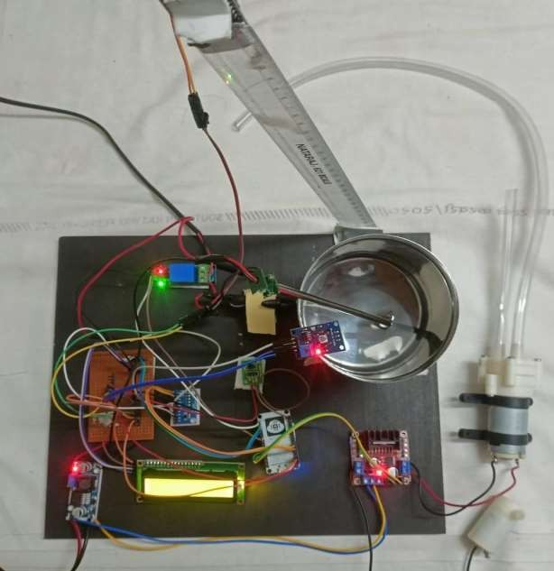
CHAPTER 6
HARDWARE IMPLEMENTATION
Fig6.1. HARDWARE MODEL

Slide 41
CHAPTER 7
CONCLUSION
In conclusion, the Industrial Milk Monitoring System (IMMS) represents a significant advancement in the dairy industry's pursuit of superior milk quality and efficient production processes. By harnessing the capabilities of IoT-based sensor technology, real-time video streaming, and an intuitive web application interface, IMMS offers a comprehensive solution that addresses key challenges faced by the dairy sector. The system's ability to continuously monitor critical milk quality parameters such as pH, gas content, and temperature, both before and after heating, ensures that the final dairy products meet stringent standards consistently.
Furthermore, IMMS's integration of real-time video feeds provides invaluable visual insights into the milk production process, enhancing the quality control mechanisms by allowing for immediate identification of any deviations or issues. The web application interface extends remote access and control to producers and quality control personnel, fostering a more flexible and agile approach to monitoring and adjustment.
The automated mechanisms, including stirring and dispensing functionalities, optimize production efficiency by minimizing the need for manual intervention, leading to increased throughput and reduced operational costs. This, combined with the assurance of consistent milk quality, significantly contributes to building and maintaining consumer trust in dairy products.

